Slide 1
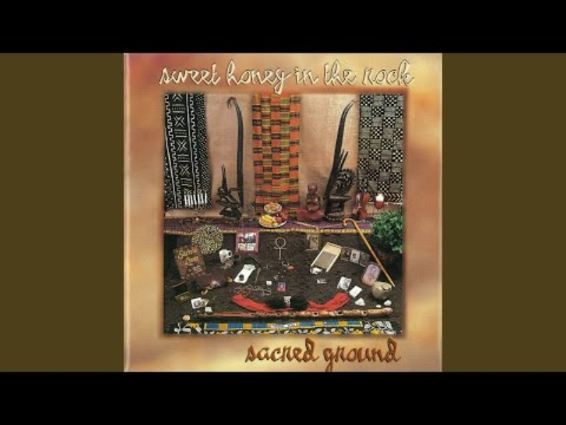

Slide 2


Understanding Trauma and Resilience 101
A Wisdom Sharing Workshop Developed by The Courage to Love in Action Collaborative

Slide 3
Workshop Goals
Participants will leave the program with increased awareness and ability to:
  Discuss the crucial role healthy relationships (personal, interpersonal, systemic and structural) play in organizational well-being. (Hospitality)
  Define trauma and toxic stress
  Understand the impact of trauma and toxic stress on our behavior, our bodies, families, and communities
  Apply practices that support the power of positive social connection to protect and heal trauma and toxic stress
  Apply practical skills for practicing trauma-informed care
Goals for 2-Days

Slide 4
Hospitality Quote
“The nature of living and loving is the act of reciprocity….What if it is the guest who gives to the host and it is the host who receives from the guest each time she sets her table to welcome and feed those she loves? To be the guest and the host simultaneously is to imagine a mutual exchange of gifts predicated on respect and joy.”
– Terry Tempest Williams, When Women Were Birds

Slide 5
Defining Trauma and Toxic Stress

Slide 6
What is Trauma/Toxic Stress? (The 3 Es)
Trauma results from an event, series of events, or set of circumstances.
Trauma is
experienced by an individual as physically or emotionally harmful or life threatening for themselves or others
and Trauma has the
effect of overwhelming our coping mechanism and affects the individual’s functioning and mental, physical, social, emotional, and/or spiritual well-being.
Effect
Event
Experience
Modified SAMHSA’s Concept of trauma- The Three “E’s” of Trauma
Notes:
There are a variety of lens to look at and define trauma through. We have adapted the definition that created by SAMHSA. We have been gifted with coping capacities that help us adapt and respond to events that threaten our sense of self and well-being. Trauma is toxic stress .

Slide 7


Slide 8
5 Categories of Trauma Exercise

Slide 9
Notes:
We have been talking about the effects of toxic stress on individuals. Now, we’re going to switch gears and talk about the effects of toxic stress on the population as a whole. The field of epidemiology is where we’ll turn.
Epidemiologists are scientists who study the origins of disease, disability, productivity and health in a population. They help us to focus our efforts on issues and processes that will make the most difference for the well-being of everyone.
We’re going to talk about a large epidemiological study about the enduring effects of Adverse Childhood Experience. Dr. Rob Anda and Dr. Vincent Felitti are the co-principal investigators of the study, which we call “The ACE Study”.

Slide 10

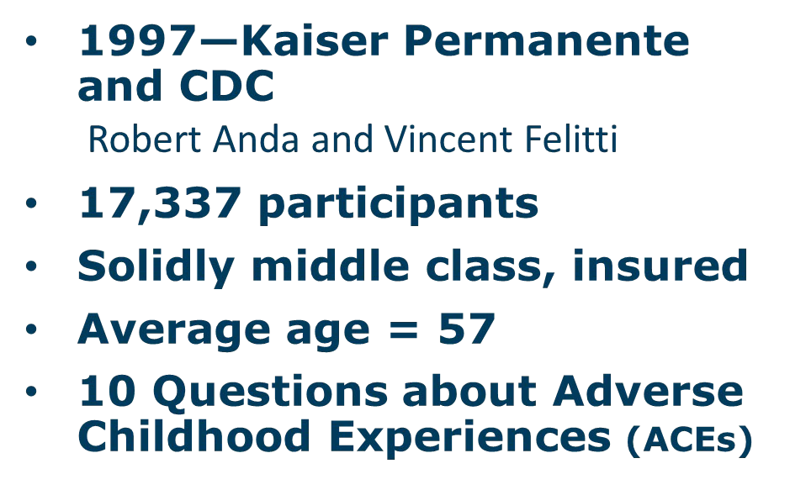
Slide courtesy of Laura Porter, ACE Interface

Slide 11
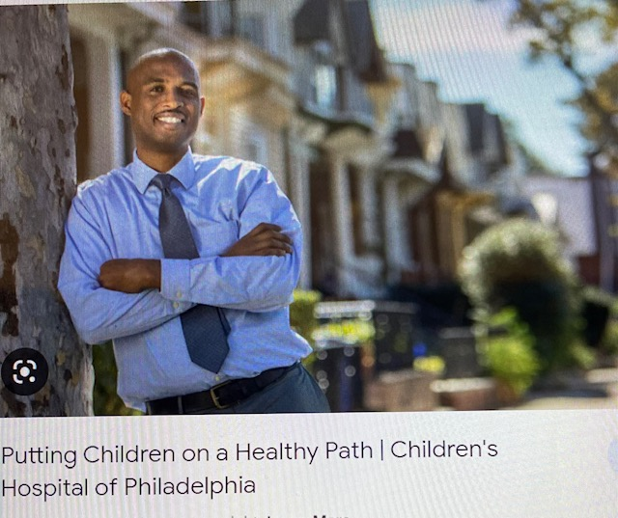
ACE Scale: Improved by Adding Additional Adversities
Expanded ACES
Property Victimization
Peer Victimization
Community Violence
Socioeconomic Status
Someone close with a serious illness
Below average grades
Parents always arguing
Lack of good friends
Historical trauma (racism, etc.)
Notes:
The study of we know about toxic stress and its impact is an emerging field of knowledge which began with the ACE’s study in 1997 with ACES. Dr. Roy Wade’s study expanded what we know about the factors that influence our well-being.
The additional adversities were found when Dr. Roy Wade replicated the original study in an urban population that was diverse.

Slide 12
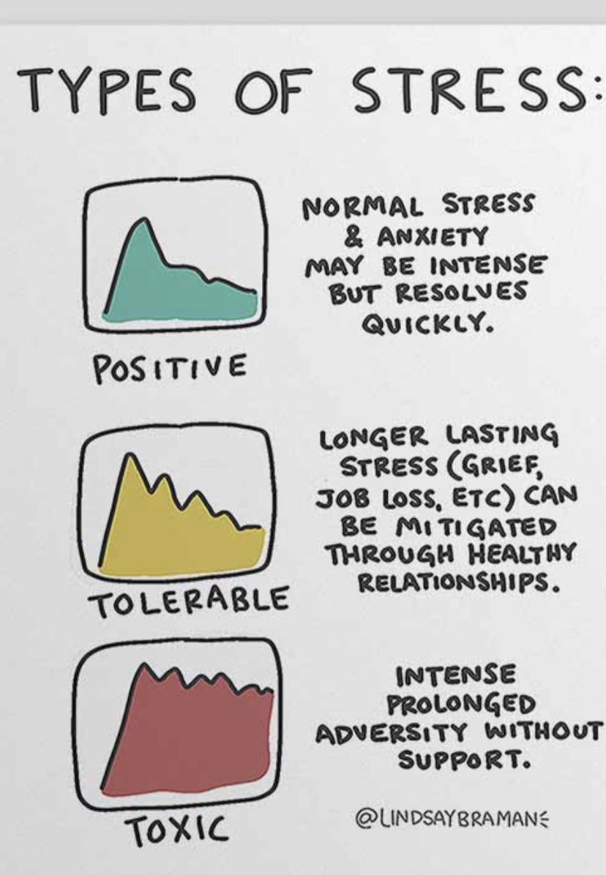
We all experience stress
It can be good and/or bad
Source: Types of Stress: A Psyhoeducational Doodle LindseyBraman.com
Notes:
Some stress is normal and good. Positive stress helps to adapt and manage our encounters with the environment within which we live . Without it, we are not able to respod to our environment and social environment.

Slide 13
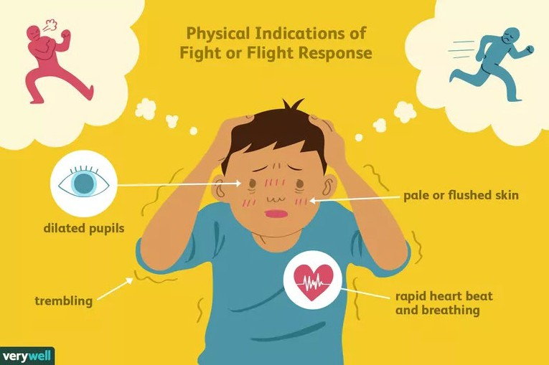
Notes:
Flight, fight or Freeze

Slide 14
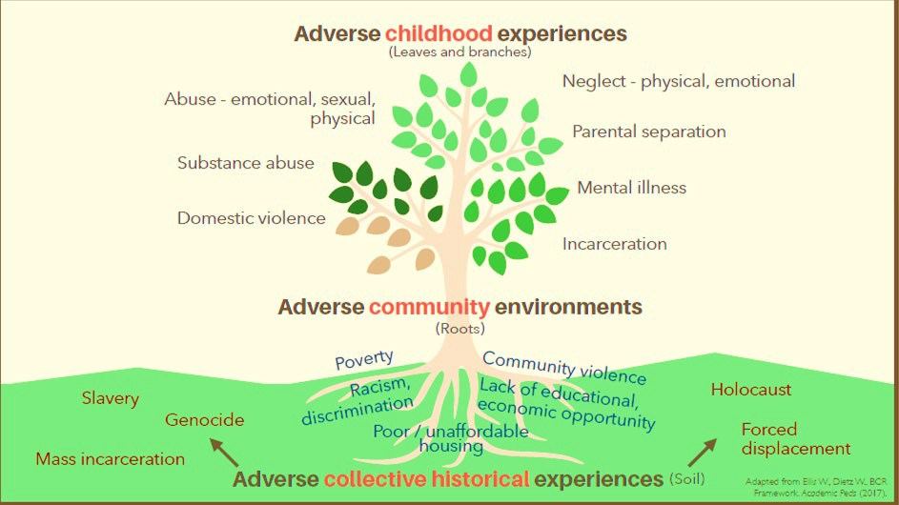

Slide 15
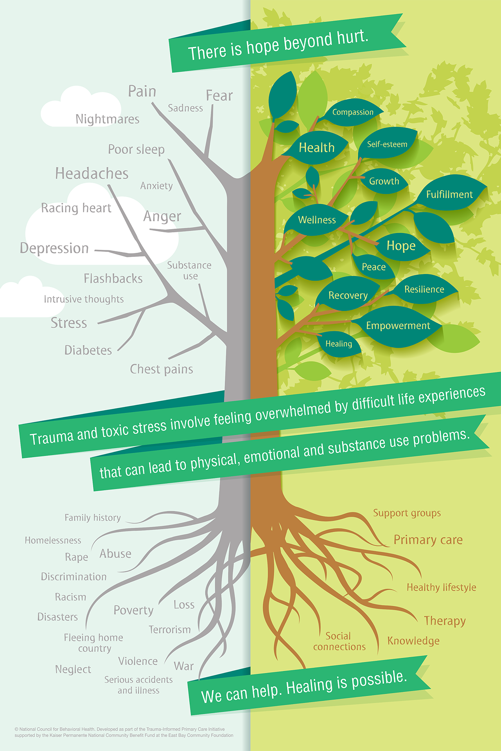
Notes:
It may also lead to spiritual problems.

Slide 16

What do we know about how trauma (and love) impact our bodies and our behaviors?

Slide 17

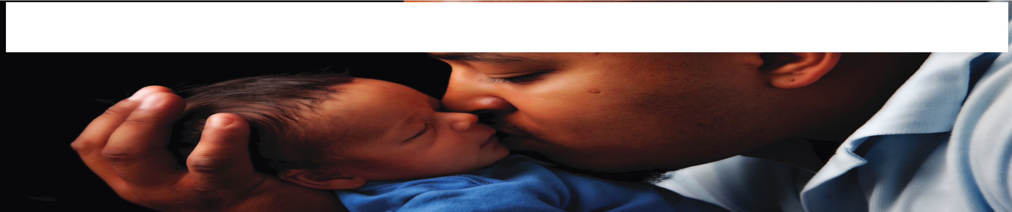
The child may not remember, but the body does!
Notes:
Presenter Notes
2024-08-29 13:50:28
--------------------------------------------
The scientific debate over nurture vs. nurture is over. We know now that the memoryof childhood experience -- is stored in our bodies, and not just our minds.
From that first spark of life, as cells divide and form a tiny human being, experience has a profound impact on who we are and who we will become.
In the past couple of decades, there has been an explosion of new understanding – beginning with the Adverse Childhood Experience, or “ACE” Study – about how and why adversity and trauma can reliably predict risks for mental, physical, behavioral health and productivity in the population.
This is great news! What’s predictable is preventable – because of recent discoveries in neuroscience, epigenetics, epidemiology, and resilience studies, we can understand how protection, prevention, and resilience promotion can profoundly improve health, safety & productivity, and reduce public and private costs now and for generations to come.

Slide 18
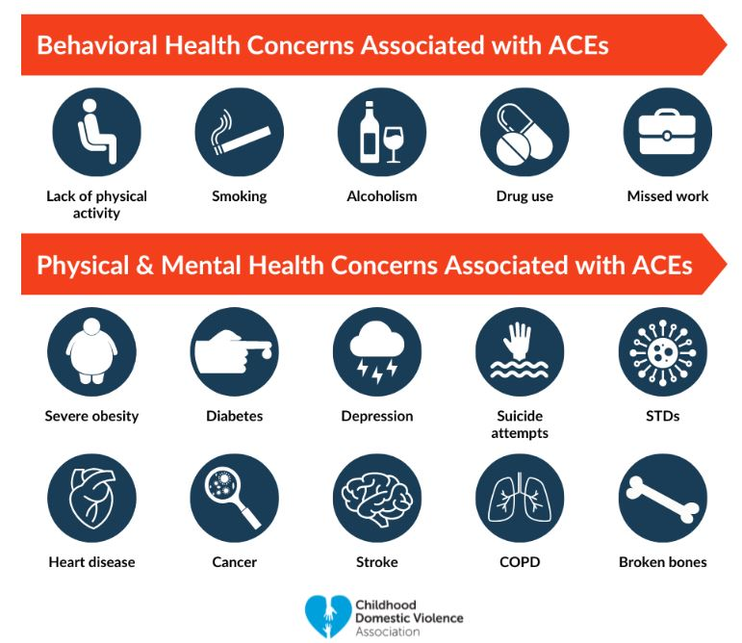

Slide 19
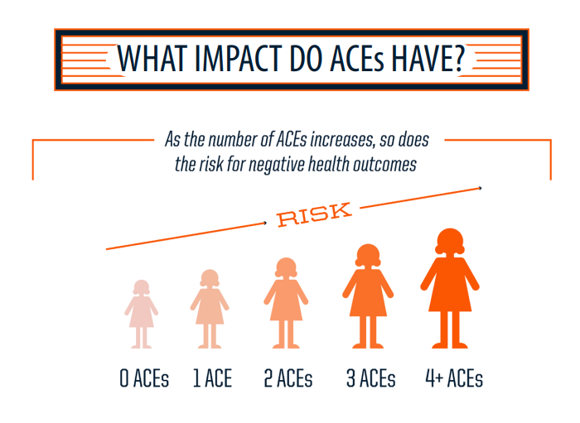

Slide 20
Out of 100 people…
33%
Report No ACEs
51%
Report 1-3 ACEs
16%
Report 4-10 ACEs
With 0 ACEs
1 in 16 smokes
1 in 69 experience alcoholism
1 in 480 use IV drugs
1 in 14 has heart disease
1 in 96 attempts suicide
With 3 ACEs
1 in 9 smokes
1 in 9 experience alcoholism
1 in 43 use IV drugs
1 in 7 has heart disease
1 in 10 attempts suicide
With 6+ ACEs
1 in 6 smokes
1 in 6 experience alcoholism
1 in 30 use IV drugs
1 in 6 has heart disease
1 in 5 attempts suicide
Notes:
These ratios are based on the original data. This slide highlights the assertion that chronic diseases occur as a result of high risk behaviors often initiated in adolescence.

Slide 21
On average, people with 6 or more ACEs are at risk of dying 20 years earlier than their peers who have not experienced these adversities.

Slide 22
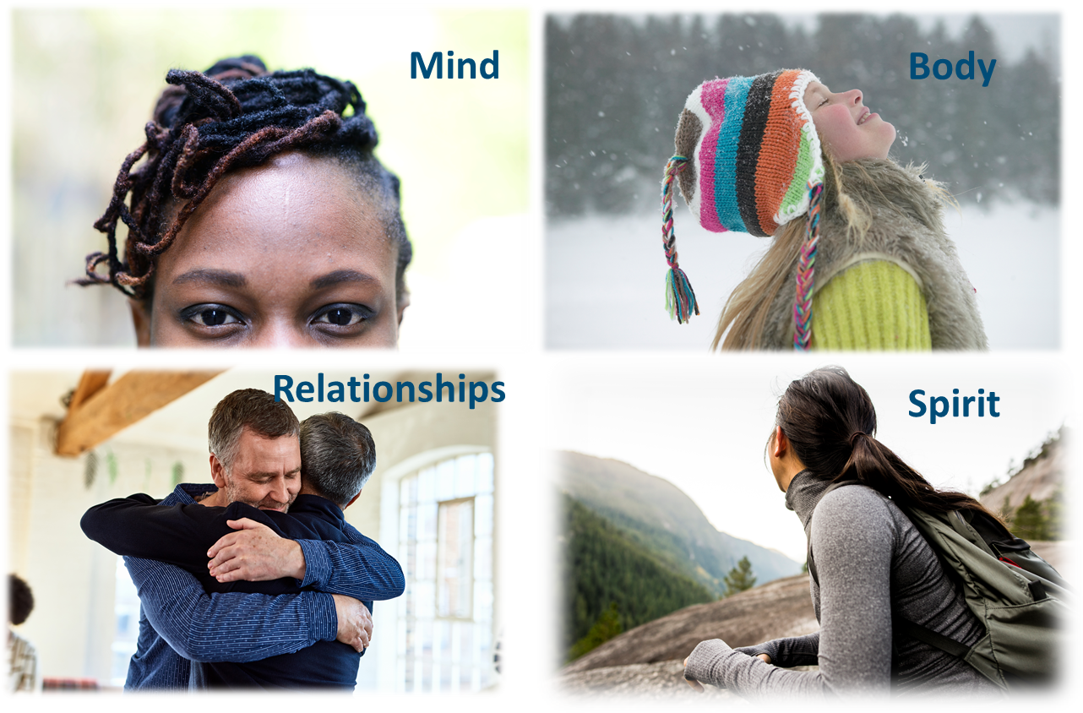
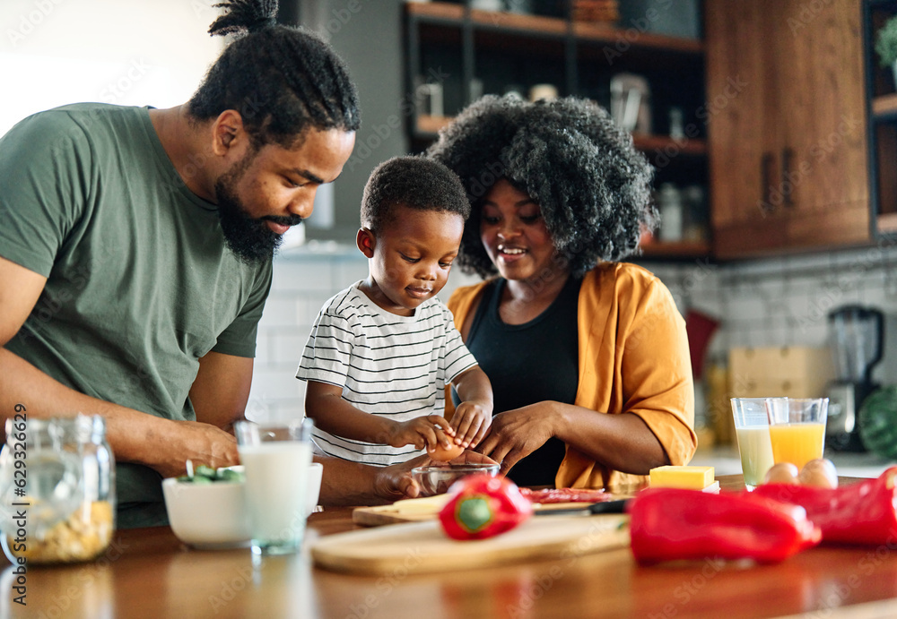

Trauma has a significant impact in many parts of our lives.
Family
Community
Notes:
Now we will talk about the things related to the impacts of trauma and how this happens.
The traumatic experiences we go through impact our mind, body, relationships, and spirit.
But, the experiences that are positive/supportive also impact our mind, body, relationships, spirit

Slide 23
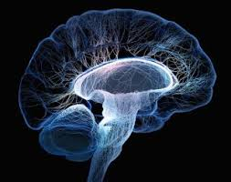
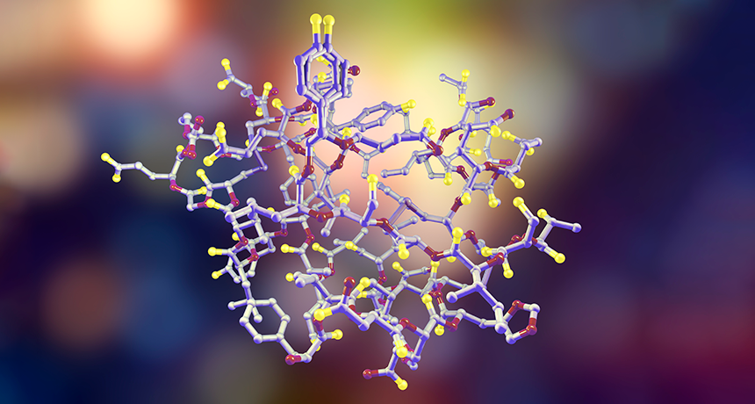
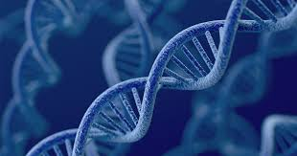
How does it work?
Brain
Hormones
Genes

Slide 24
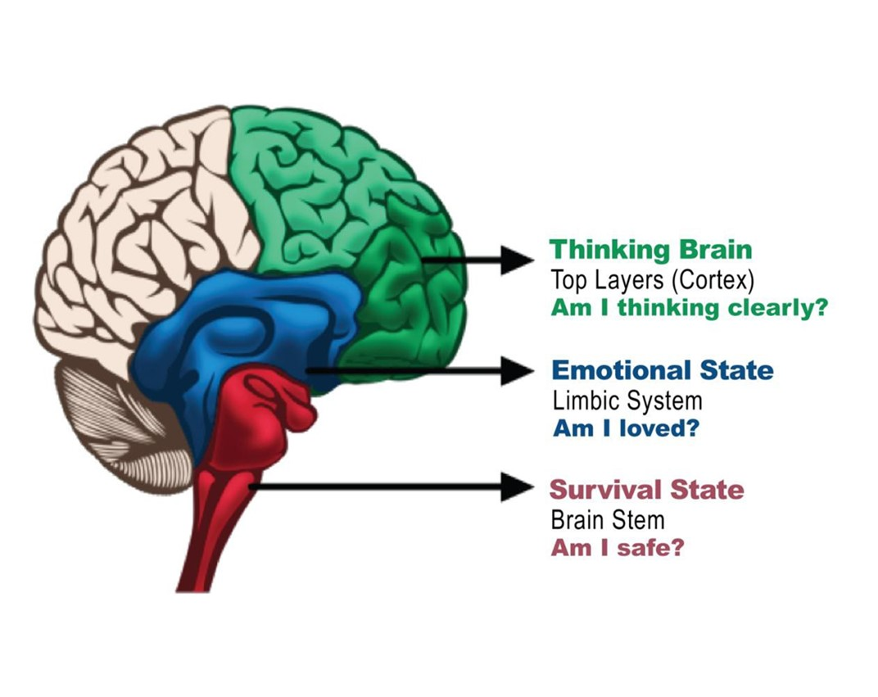
Neurobiology—How Our Brains are Set Up

Slide 25
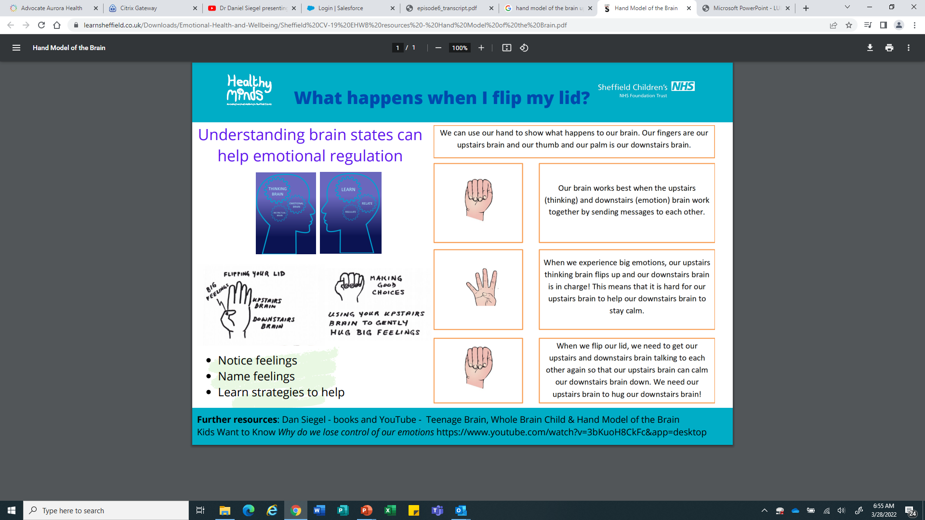
The Hand Model of the Brain
Dan Siegel

Slide 26
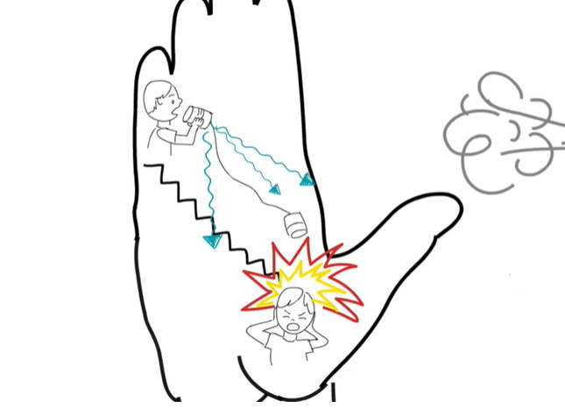

Slide 27
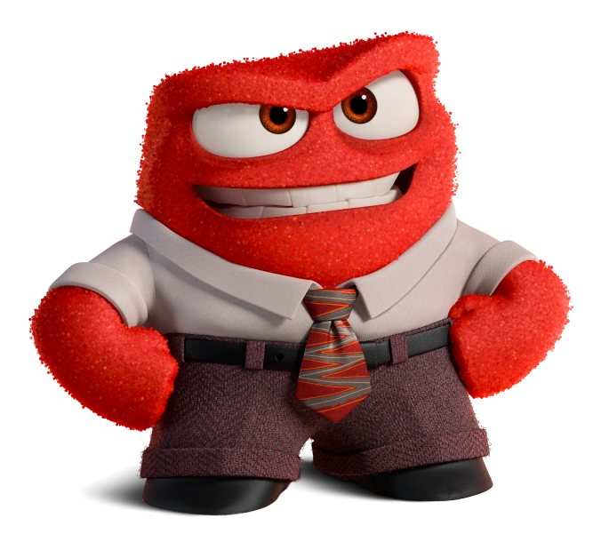

Slide 28


Slide 29
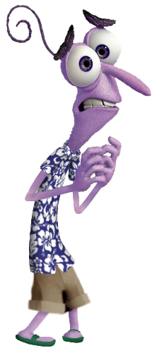

Slide 30

Pair and Share
Think about what makes you flip your lid.
Share a couple of examples of things that make you flip your lid.
Can you tell when you are ready to flip your lid? What do you feel? How do you know?

Slide 31
The Impact of Stress on Our Hormones and Physiology

Slide 32
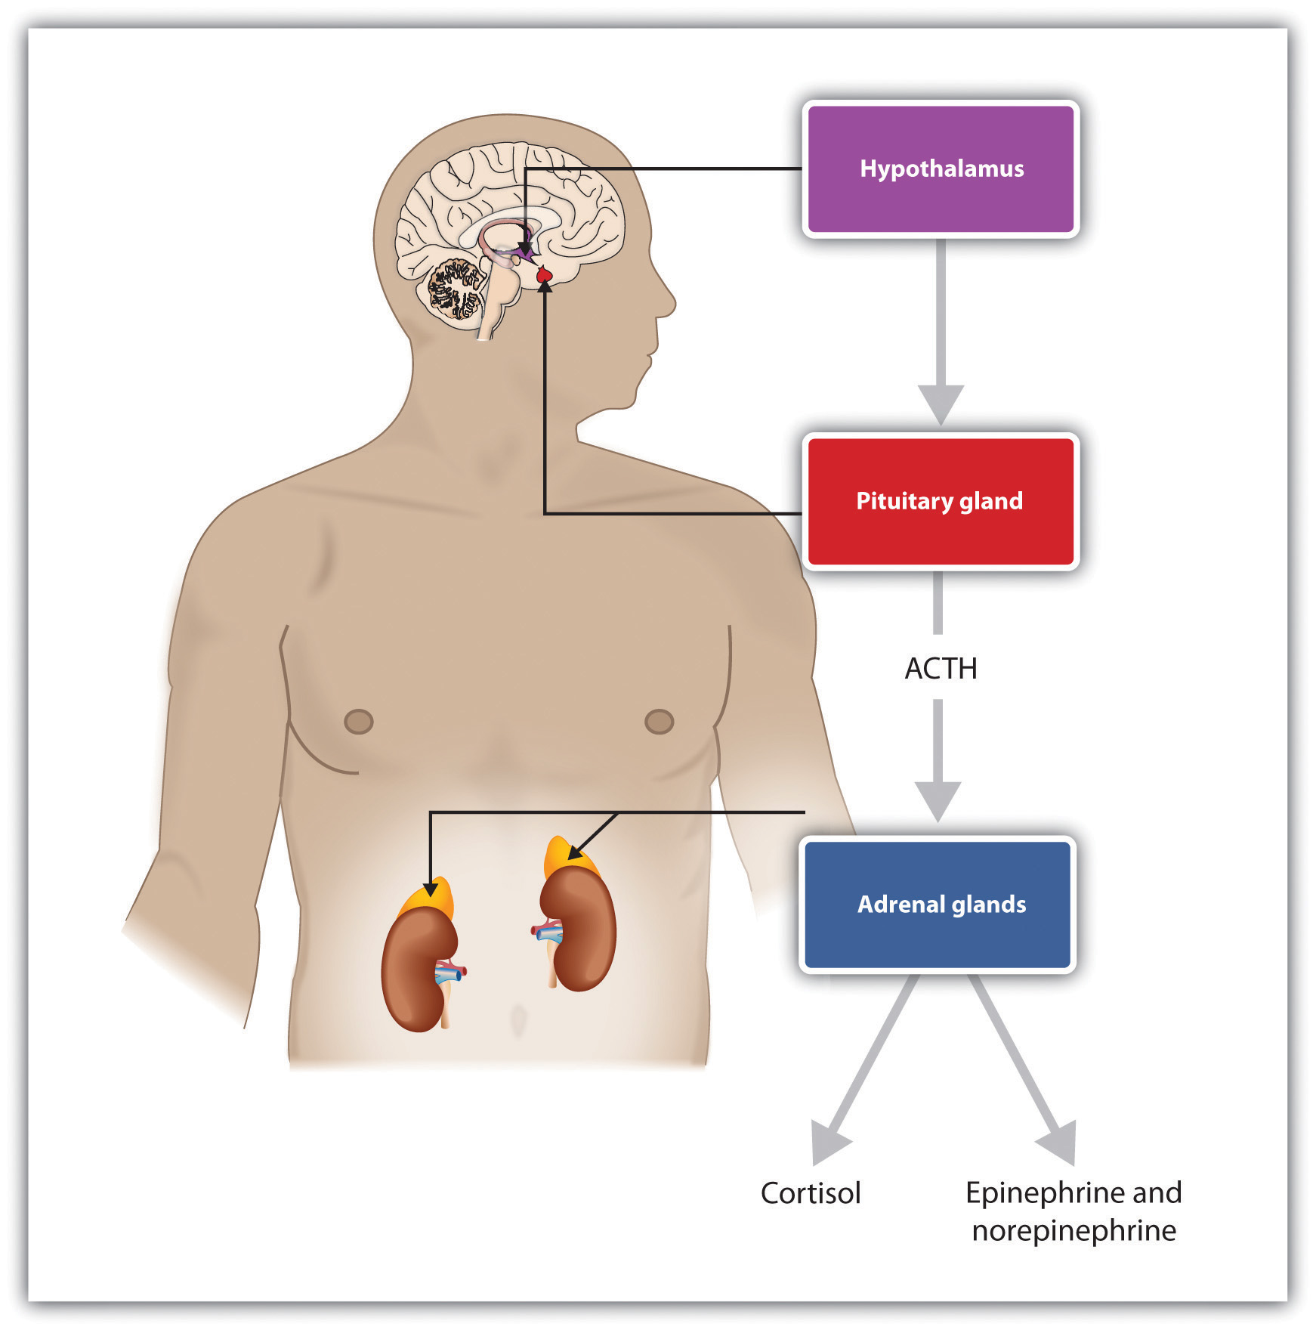
The “HPA” system regulates our hormones.
It’s how our bodies process our experiences.
Slide courtesy of Laura Porter, ACE Interface

Slide 33
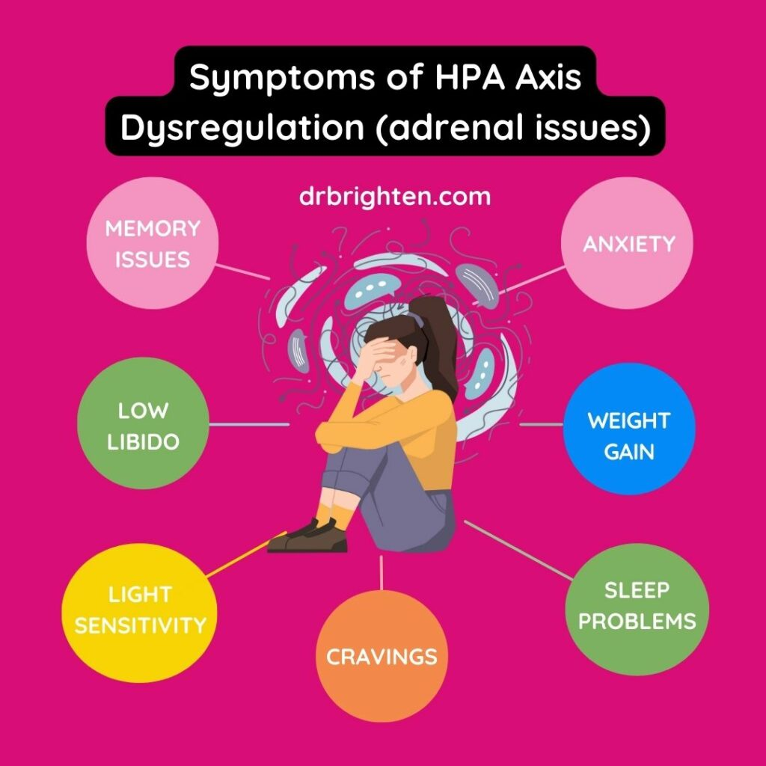

Slide 34

Intergenerational
Impacts
Experiences that we have can turn our genes on or off, affecting how our bodies function.
We pass those modified genes on to our children.
The study of this phenomena is called epigenetics.

Slide 35
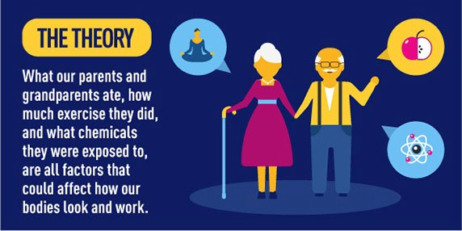
ACEs and the Next Generation
http://www.nestle.com/media/newsandfeatures/nestle-research-epigenetics

Slide 36
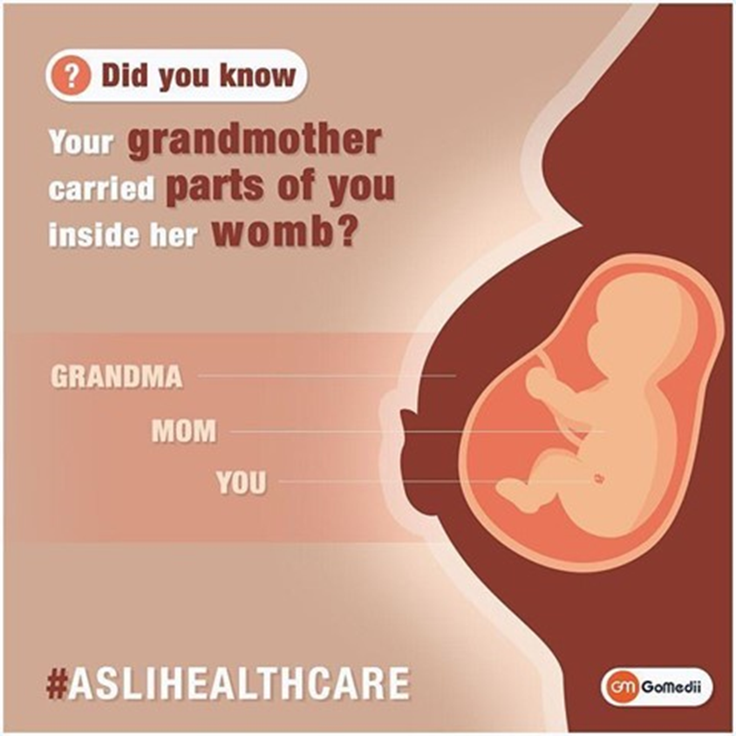
3 Generations
Notes:
This is an illustration of how trauma / stress affects your genetic function, depends on our experiences.
Generational stress and trauma is passed down from your grandmother to you.
And resilience/love/strength, grit is passed down

Slide 37
Our Experiences Impact Our Behaviors
OUTCOME
Individual & species survive the worst conditions
Dangerous
CHARACTERISTICS
“Brawn over Brains”
Focused: Fight, Flight or Freeze
A bad match between what we are trained to expect and what actually is happening in the social environment fuels problems
Conception
  Safe
TOXIC STRESS
BRAIN
Prepares for anticipated world
CHARACTERISTICS
”Process over Power”
Multi-focused: Relational
OUTCOME
Individual & species survive in good times; vulnerable in poor conditions
Behavior is adaptive, not wrong
Slide by Laura Porter, ACE Interface. Adapted from the research of Martin Teicher, MD, Ph.D
Notes:
We all start with a brain that will adjust.
The top line is what happens when life is tough. In this case, traumatic stress means any condition that causes the stress hormones to be elevated for protracted periods of time. If our early experience includes danger or trauma, then chemicals are release that act on our cells, brain chemicals and other essential systems. We adapt to be quick to anger, quick to act and very tough. This requires brawn over brains…take what you need, ask questions later. And frankly, individuals and the species will do much better in times of trouble if this is how we behave.
On the other hand, if early experience is warm, friendly, kind and loving, then our brains are bathed in soothing, happy hormones and we grow up relationship-oriented, willing and able to share, and be patient. We value process over power. And that’s great for a world where everyone gets along, shares and strives for peace. The species wouldn’t do very well in times of trouble—like war, famine or other threats to survival—if we all had these characteristics.
We’re only really made to be under stress for about 20 minutes at a time. So experiences like child abuse, neglect or even being in a war zone or a famine cause our stress hormones to be continuously produced. Our bodies prepare for a tough life in a dangerous world. Stress hormones exert influence on cells, chemicals and wiring. They develop brains that are wired for certain characteristics – like being edgy, hot tempered, impulsive and hyper vigilant. This is the path outlined on the top line of the slide. For example, people who have had traumatic stress from conception to the toddler years will likely have a higher baseline of the stress hormones like cortisol in their bodies. As a result, these folks may have a very short fuse and a difficult time calming themselves. If there is more danger just around the corner, rapid calming wouldn’t contribute to survival—readiness for a next danger would.
One strong mental model in our society is that the people whose experience takes them on the top path are maladaptive and the people along the bottom path are adaptive. That’s untrue…both pathways are adaptive. Both brains are adapting to their experience. And that’s good for us as a species because the people whose brains are made for a malevolent world help us survive when life is tough and the people whose brains are wired for a benevolent world help our species survive in calm and happy times. Our experiences get wired into our biology.
Dr. Teicher says it’s when our biology collides with social expectations that we run into trouble. A child from the top path is not going to sit still—sitting still is a “sitting duck”. He or she is not going to share, cooperate or use words as their first choice. When that child comes to school and we ask them to sit still, share, cooperate, etc, there is a painful disconnect that can be very hard for everyone. Likewise, if you put a person from the benevolent world into the dog-eat-dog competition of say, Wall Street, that person is going to struggle. It’s the context we end up in that determines how functional our adaptations really are.
We can’t change people’s biology—or at least we don’t know how to do that yet. But we can teach skills. For example, we do teach girls who are very trusting and relationship oriented to keep themselves safe. We teach self defense and other common sense tools. We may want to think about whether we can teach tools to individuals on the top path way, too. Is there a way to take “impulsive” and add skills so that the individual is a very decisive and capable leader, who is able to act quickly with limited information? What might it take to accomplish that?

Slide 38

Good News!
Trauma never has the last word!

Slide 39
The Impact of Love
Promoting Resilience

Slide 40

Defining Key Terms
Hospitality
Resilience
Healing-Centered

Slide 41
Hospitality is the Foundation of Relationships
Hospitality consists of little acts that make space for the growth and nurture of healthy relationships and alleviate the effects of trauma and toxic stress. At its best, hospitality is reciprocal rather than hierarchical. It is circular in its give and take.
At the service organization level hospitality can result in policies, practices, systems and structures that promote positive staff attitudes, staff retention/loyalty, improvement in staff performance, customer loyalty………

Slide 42
ResilienceDefinitionof Resilience
Resilience is the process and outcome of successfully adapting to difficult or challenging life experiences, especially through mental, emotional, spiritual and behavioral flexibility and adjustment to external and internal demands.
(Adaptation of the American Psychology Association’s Definition)

Slide 43
Healing-Centered Approach
“Healing-Centered” approach is holistic involving culture, spirituality, civic action and collective healing. It views trauma not simply as an individual isolated experience, but rather highlights the ways in which trauma and healing are experienced collectively.” (Shawn Ginwright)
The focus is on wellness and transforming the policies, systems and structure that cause harm.
Notes:
This approach addresses the roots of trauma, views and engages those who have been harmed in healing the systems, structures and policies that cause trauma, is a political model, It is strength-based. It is akin to Ubuntu, a South African concept that humanness and being are found through our interdependence, collective engagement with others to effect transformation.

Slide 44
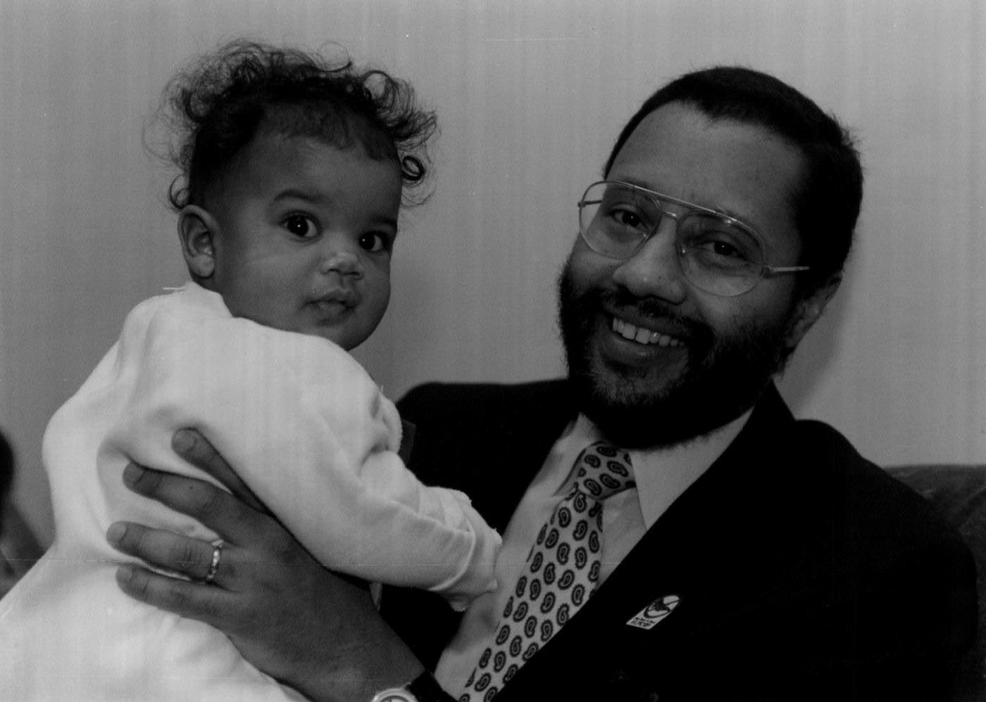
RISK FACTORS ARE NOT PREDICTIVE FACTORS BECAUSE OF PROTECTIVE FACTORS
Dr. Carl Bell

Slide 45
Healing Factors
Protective Factors - processes and relationships that prevent trauma and lessen the effects of trauma.
  (Examples: Existence of a sense of safety provided by healthy family relationships, organizational programming, practices and policies which recognize individual contribution)
Resilience Factors – processes and relationships that address trauma when it occurs by promoting resilience.
  (Examples: The infusion of practices such as mindfulness, asset identification, affirmations, resources for employee assistance and empowerment)

Slide 46
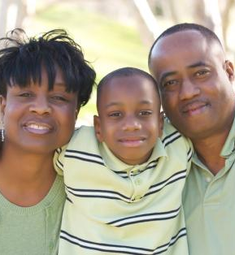
Healing Happens in Relationships
“Social support is the most powerful protection against becoming overwhelmed by stress and trauma. The critical issue is reciprocity: being truly heard and seen by the people around us, feeling that we are held in someone else’s mind and heart.”
Van der Kolk, 2014, The Body Keeps the Score

Slide 47
What Can You Do Today?
Notes:
There is not cookie cutter – no right way to
Giving you general principles
Skills for you to develop
Future training, we can get into skill building
Ideas of things you can start doing
Stop for resiliency pause

Slide 48


What happened to you?
What have you been through?
Rather than…
What’s wrong with you?
What’s right with you?
What is right with your community?
How is this behavior helping you?
Who are you?
Shift from judgement to curiosity!

Slide 49

The Science of Thriving H.O.P.E.
Social, emotional competencies
Safe, Stable, Equitable Environment
Healthy Outcomes from Positive Experiences
Trauma
Interpersonal Community Historical
Social engagement
Nurturing, supportive relationships
Moral Injury
PTS(D)
Facilitating healthy relationships is the common denominator
Being Seen and Valued
Balancing ACEs with HOPE. 2017 Casey Family Programs Report.
Adapted from graphic by Linnea Winquist, Chaplain, Lurie Children’s Hospital
Notes:
“Moral injury is the damage done to one’s conscience or moral compass when that person perpetrates, witnesses, or fails to prevent acts that transgress their own moral and ethical values or codes of conduct.” The Moral Injury Project, Syracuse University “Moral injury is a complex wound of the soul.” NCPD.org
Post-traumatic stress disorder (PTSD) is an intense physical and physical and emotional response to thoughts and reminders of a traumatic event that last for many weeks or months after the event. National Survey of Children’s Health

Slide 50
Trauma Responsive Communities
6 R’s
Trauma Informed Principles
Realize
Recognize
Respond
Resist Re-Traumatization
Repair
Resilience
Safety
Trustworthiness
Choice
Collaboration
Empowerment
Cultural, Historical, & Issues
Companionship
Relationship
(SAMHSA and CDC. With adaptation by Chicagoland Trauma Informed Congregations Network)
Notes:
Companionship and relationship
Go through the TIP
Ask how or what faith leaders are doing to create these environments? How do we work at these?
Safety – the physical setting is safe and interpersonal interactions promote a sense of safety
Trustworthiness – decisions conducted with transparency with the goal of building and maintaining trust
Choice – freedom to of voice and choice is always included
Collaboration – importance is placed on partnering and the leveling of power differences
Empowerment – individuals’ strengths and experiences are recognized and built upon
Cultural & Historical Issues – actively names and works to dismantle past cultural stereotypes and biases; leverages the healing value of traditional cultural connections; and addresses historical trauma
Realize. People at all levels of congregation have a basic realization about trauma and understand how trauma can affect individuals, families, groups, organizations, and communities.
Recognize. People in the congregation recognize the signs of trauma.
Respond. Actively practice what we know brings healing and resilience in all areas of the congregation.
Resist Re-Traumatization. Be gentle with each other. Apply relational healing modes, especially in situations of conflict or disruption.
********************
Repair. Acknowledge ways in which our faith communities have been sources of trauma through abuse, judgement, rejection and abasement and actively work to repair relationships.
Resilience. Trust the power and wisdom of our scriptures and spiritual practices to cultivate resilience and well-being across all ages.

Slide 51
A Framework for a Trauma Conscious and Healing Engaged Culture--The 6 Rs
Realize. People at all levels of congregation have a basic realization about trauma and
understand how trauma can affect individuals, families, groups, organizations, and communities.
Recognize. People in the organization recognize the signs of trauma and the practices of resilience and HOPE.
Respond. Actively practice what we know brings healing and resilience in all areas of the congregation.
Resist Re-Traumatization. Be gentle with each other, apply relational healing modes, especially in situations of conflict or disruption.
********************
Repair. Acknowledge ways in which our faith communities have been sources of trauma
through abuse, judgement, rejection and abasement and actively work to repair relationships.
Resilience. Trust the power and wisdom of our scriptures and spiritual practices to cultivate resilience and well-being across all ages.

Slide 52
Relational Healing Model
Survivor as an expert on themselves
  Focus on collaboration and decreased dependence on an all- powerful expert
Symptoms as adaptations rather than pathologies
  How does this behavior help this person?
Boost Self-Capacities
  Feeling worthy of Life
  Managing feelings
  Carrying sense of positive connection with another
The relationship itself is the healing intervention
The “person” of the helper matters
  Do your own work. Build self-awareness.
  Attend to vicarious trauma
(Risking Connection in Faith Communities. Sidran Institute)

Slide 53
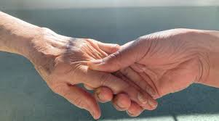
Positive experiences of social connectedness nurture our self-capacities
Self-Capacities
Feeling worthy of life
Managing and modulating feelings
Carrying sense of positive connection with another, even in their absence
When we
Self-Capacities,
we
Crisis
(Adapted from Risking Connection in Faith Communities. Sidran Institute)

Slide 54
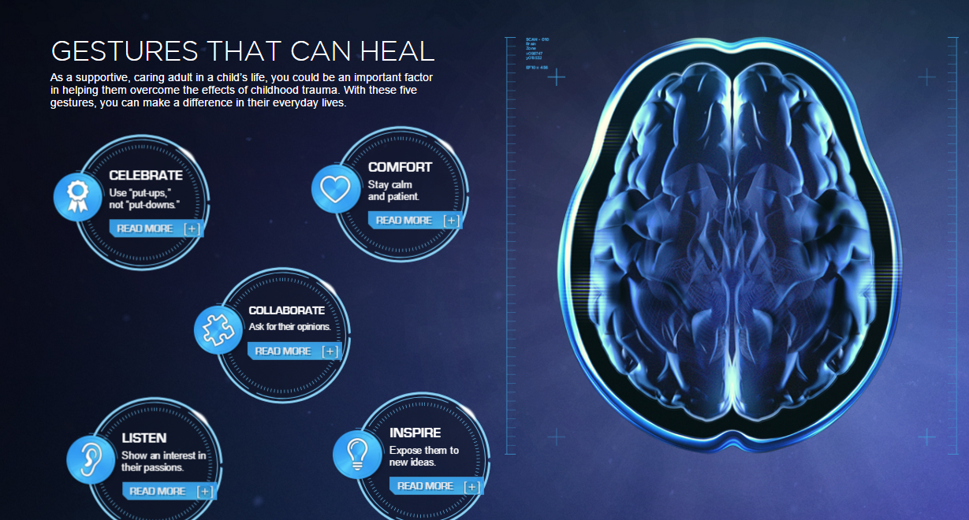
5 Healing Gestures: https://changingmindsnow.org/gestures
Notes:
Aces show that people who have adverse child hood experience are more likely to have poor health outcomes as adults
But, we know that protective factors are not predictive factors.
Changing minds.org developed the five Healing Gestures specific to children, but can used with adults
It is evidence based and helps build resilience and help people to heal to bring out their strengths.
There are five healing gestures you can provide care – things all of us can do
Celebrate – build up self-esteem
Comfort – stay calm- people who experience violence may act out – assure their safety
Collaborate – Ask for opinions to support them so they can overcome challenges in their lives
Listen – deeply show interest to boost confidence – eye contact
Inspire – Expose to new ideas and to imagine the possibilities – highlight gifts to help increase confidence.

Slide 55
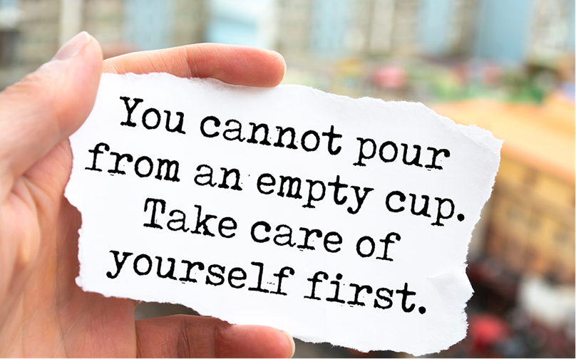
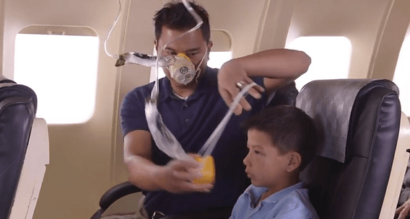
Self Care
A necessary essential for your effectiveness and sustainability

Slide 56
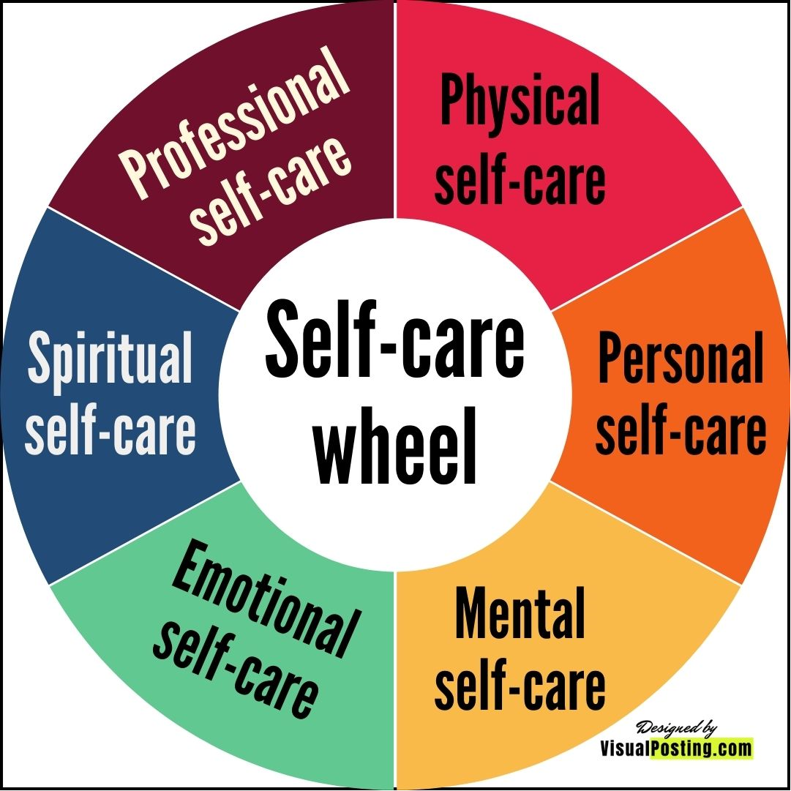

Slide 57
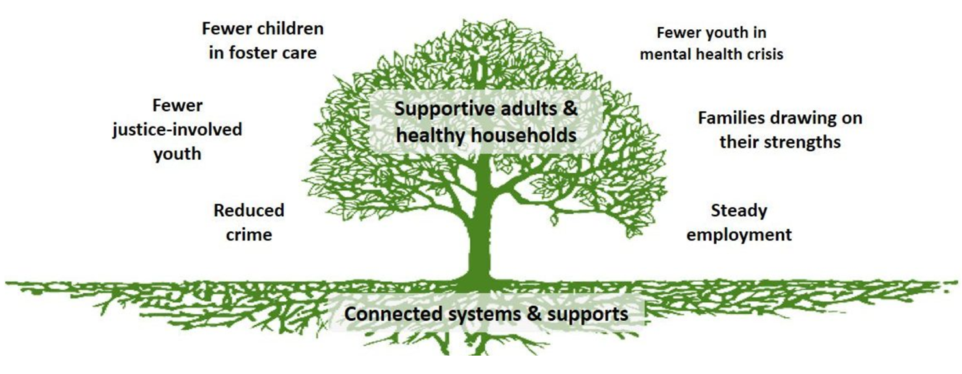
Resilience Tree adapted from Building Community Resilience
High quality education for all
Just economic systems
Peaceful resolution of global conflict
Racial equity/
Abolition
Restorative justice systems
Notes:
Just like we have the trauma tree
We have the resilience tree to create the things we want in our community (call out)

Slide 58
Thank You!

