Slide 1
Tai Chi for Resiliency
“Strengthening the Body, Heart-Mind, & Spirit”
An ancient concept for a chaotic time
From: Aurora Integrative Medicine

Slide 2
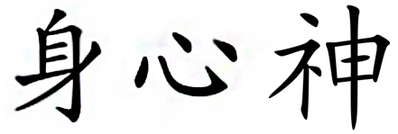
Tai Chi for Resiliency
Strengthening your body, heart-mind, and spirit can help us reduce stress and improve our sense of resiliency.
This is an ancient concept that we can use in this chaotic time
Developed hundreds of years ago, Tai Chi is the quintessential “dance of awareness” to be able to strengthen your Body, Heart-Mind, and Spirit to help you overcome life’s challenges.
Body Heart-Mind Spirit

Slide 3
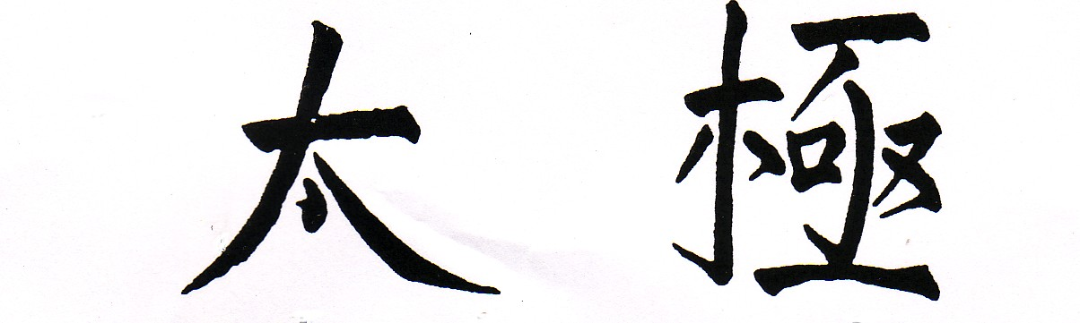
Tai Chi for Resiliency
Tai Chi (pronounced “Tie Jee”)
Translates to:
  ‘‘Supreme Ultimate’’
This empowering message can remind us all that we are all born with our own unique “Supreme Potential” to confront and overcome our “Ultimate Challenges”

Slide 4
Tai Chi for Resiliency
These evidence-based practice principles of Tai Chi can be utilized by everyone at any time to maximize an individual’s ability to reduce stress and improve one’s sense of resiliency:
  Body Posture
    Research: Adopting an upright posture in the face of stress can maintain self-esteem and improve your mood¹
  Deep Breathing
    Research: Decisively influences reductions in fear and anger²
  Being Mindful to promote muscle relaxation
    Research: A viable approach to reduce anxiety and depression³
  Perform Rhythmic Movements
    Research: Slow rhythmic movements in Tai-Chi attenuates stress⁴

Slide 5
Tai Chi for Resiliency
How you can use this: whenever you have the time, especially when feeling stressed, use these Tai Chi practice principles for 1-2 minutes:
Assume a posture of confidence
Breathe deeply
Relax the muscles you do not need while moving rhythmically
  For example: when standing, slowly turn your body to the left and right with your arms hanging loosely by your sides.
Be mindful to how you are feeling with an understanding that if you name it you can control it:
  For example: “As I inhale I know I am anxious or afraid as I exhale I know I can control it”. Feel the power of Resiliency!

Slide 6
References:
Nair, S., Sagar, M., Sollers, J. III, Consedine, N., & Broadbent, E. (2015). Do slumped and upright postures affect stress responses? A randomized trial. Health Psychology, 34(6), 632-641.
Volker Busch, Walter Magerl, Uwe Kern, Joachim Haas, Göran Hajak, Peter Eichhammer, The Effect of Deep and Slow Breathing on Pain Perception, Autonomic Activity, and Mood Processing—An Experimental Study, Pain Medicine, Volume 13, Issue 2, February 2012, Pages 215–228
Edenfield TM, Saeed SA. An update on mindfulness meditation as a self-help treatment for anxiety and depression. Psychol Res Behav Manag. 2012;5:131–141. doi:10.2147/PRBM.S34937.
Yeung A, Chan JSM, Cheung JC, Zou L. Qigong and Tai-Chi for Mood Regulation. Focus (Am Psychiatr Publ). 2018;16(1):40–47. doi:10.1176/appi.focus.20170042

