Slide 1
How You Are Matters
Thriving in your life with others
January 30, 2020 | Chaplain Staycie Flint

Slide 2
Pause / Notice

Slide 3
Resilience is about how you recover, not how you endure.
Notes:
All the choices in the day for others and self
Who we are and what is important integrated into how we spend our days
Figure out how to enter in and engage
Recovery is allowing essential parts of ourselves to come away from all that is important while staying connected

Slide 4
Notes:
Ultimately self care is about assessing which sort of care is best to engage when.

Slide 5
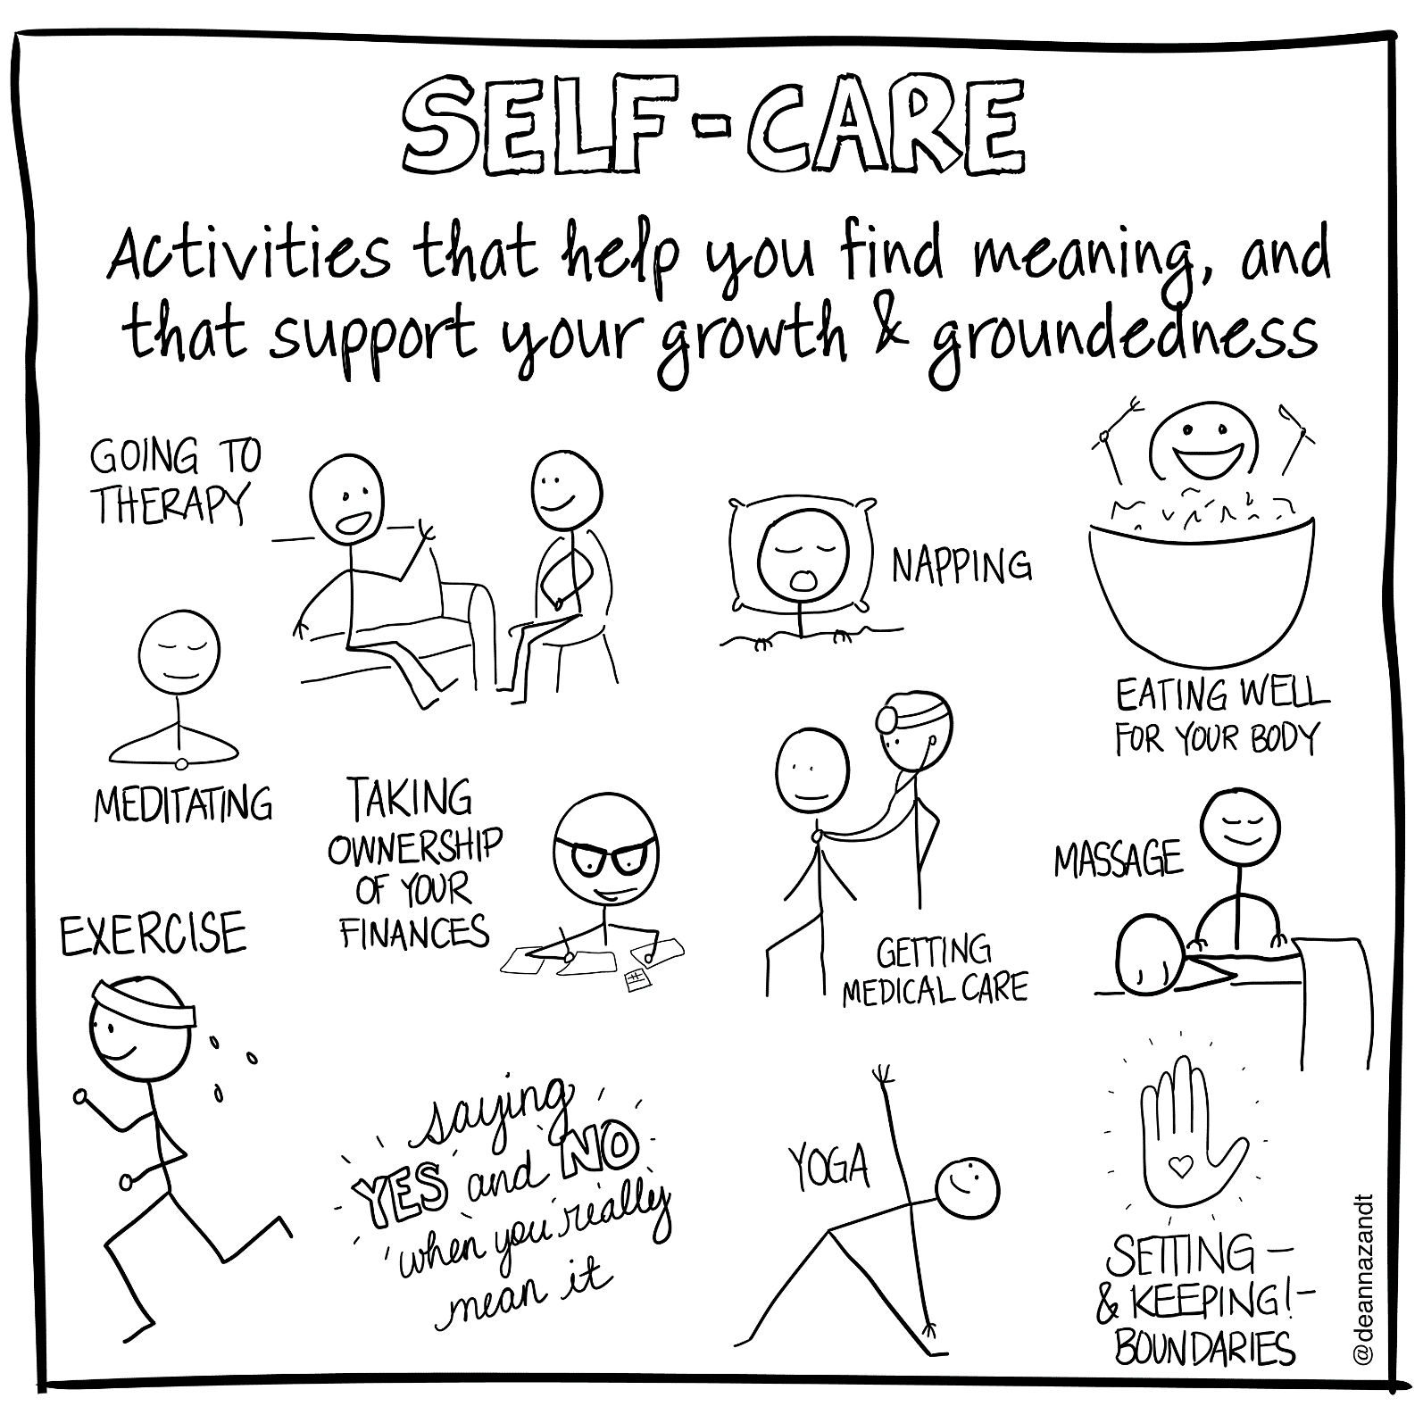

Slide 6
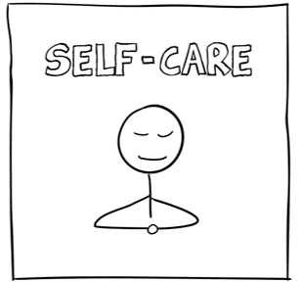
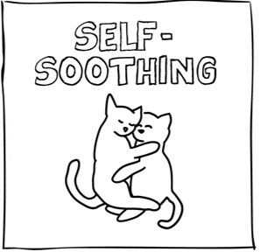

Slide 7
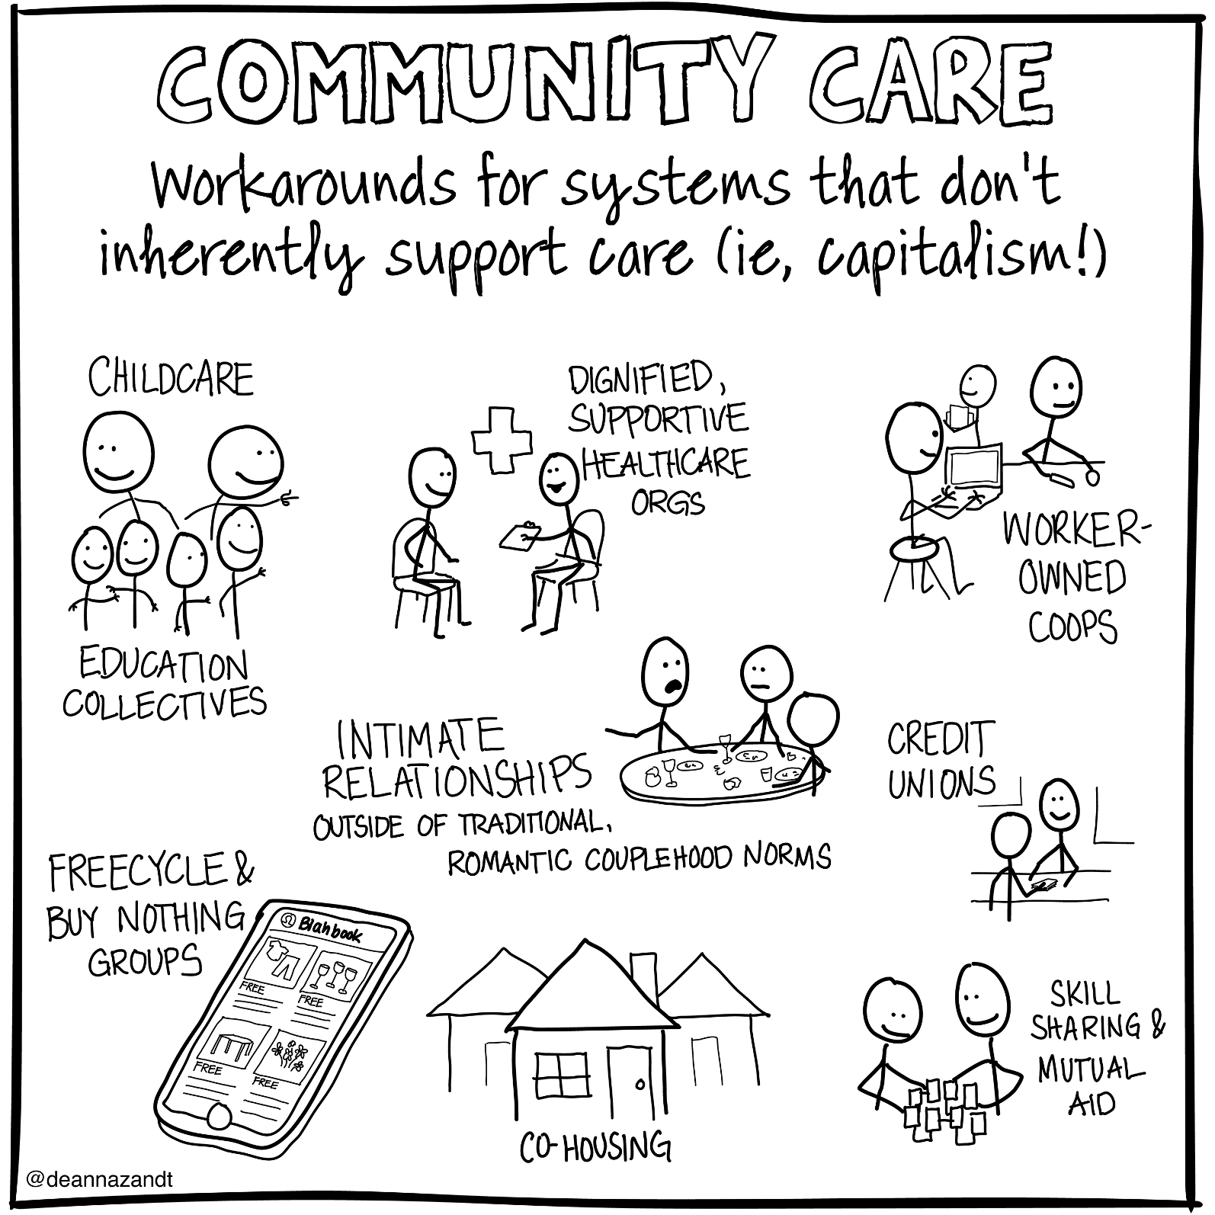

Slide 8
Notes:
Ultimately self care is about assessing which sort of care is best to engage when.

Slide 9
Self-advocacy^{29,30} is the ability to effectively communicate and negotiate for one’s wants and needs.
To practice self-advocacy is to intentionally incorporate practices into one’s life that respect oneself as whole and empowered.
Notes:
Understanding self-care as a vital part of self-advocacy is part of equity movement for those with diverse needs
For example, if I want a book off a high shelf I ask someone to get it for me and say thank you.
Self-advocacy also means I take responsibility for my choices.
I adopted a dog so I make sure to give him food, water, and exercise.
I choose to work in health care and both joy and suffering so I take responsibility to stay open joy and suffering … which means caring for my self and those around me

Slide 10
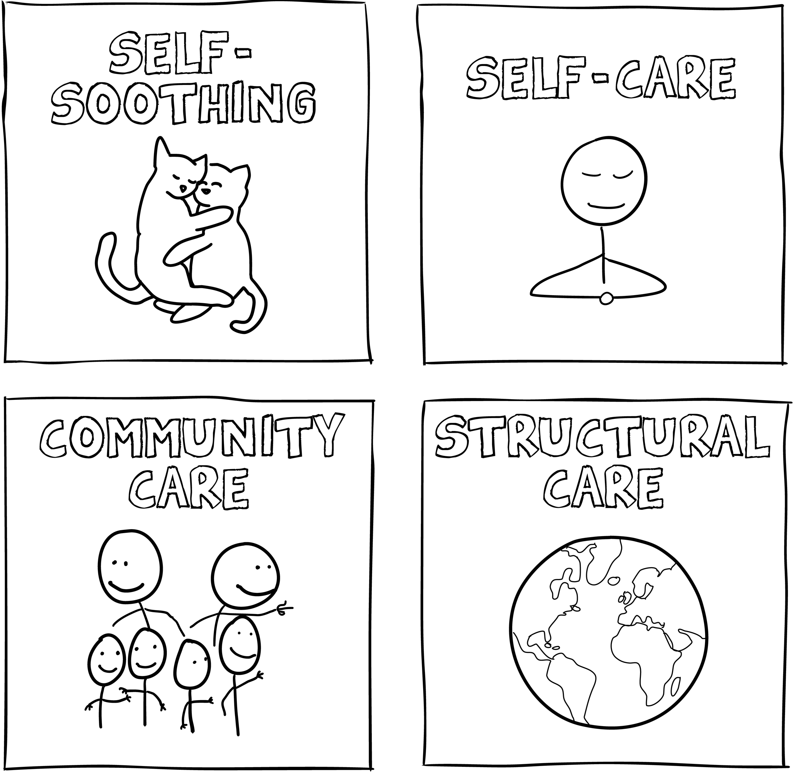
How Are You?
Expressive writing.
Pen constantly moving either writing words or drawing.
You will not be asked to share what you have written.
Notes:
Consider you own life and how you are doing with moving in between these ways of offering care to the world and your-self

Slide 11
Let’s Get Some Sun

Slide 12
What super-powered talents or resources do we have available to us at all times?
Team up
Create a list of 5 superpowers you notice in other people. Use one or two words for each power. (7-10 min)
Place List up on the wall

Slide 13
What super-powered talents or resources do we have available to us at all times?
Solo Flight
Review all the superpower lists and consider your own.
(5 - 7min)
In 1 or 2 words write them in bold on an index card (2min)
Notes:
This is not a time for modesty.
Also, there may a primary source underneath many of the superpowers you are considering (e.g., I am good at noticing... so that makes me good at finding, discerning, and analyzing). Dig deep.
one or two words and write them in bold in a large index card;

Slide 14
What super-powered talents or resources do we have available to us at all times?
Arch Nemesis
What is a positive way to describe their superpower? (4min)
In 1 or 2 words write down the superpower of your nemesis on the opposite side of your card (2min)
Notes:
Now consider a person who effectively blocks your superpower.
Their power is just as strong as yours.
Name it.
If the name sounds negative, flip the negative to a positive. Imagine how your nemesis might describe their own superpower.
This might be hard. Ask your neighbor for help if you are stuck.
Write down the superpower of your nemesis on the opposite side of your index card. Write down the superpower of your nemesis on the other side

Slide 15
Speed Rounds
Pair up with someone
In two minutes each, share both sides of your cards (4min)
Repeat two times in different pairs (10min)
Notes:
(10 min) Invite participants to share both sides of their cards in three rounds of different pairings (Impromptu Networking);

Slide 16
Secret Lair
Complete the sentence
"My superpower is to ...“
"Something I noticed about my superpower is ....“
"My nemesis can help me to ... “
"I can make better use of my superpower toward self-advocacy by ... "
Notes:
Change to above slide

Slide 17
Advocacy is the ability to effectively communicate and negotiate for the wants and needs of others.
Advocating for others is to intentionally incorporate practices into one’s life that respect others as whole and empowered.
Notes:
Understanding self-care as a vital part of self-advocacy is part of equity movement for those with diverse needs
For example, if I want a book off a high shelf I ask someone to get it for me and say thank you.
Self-advocacy also means I take responsibility for my choices.
I adopted a dog so I make sure to give him food, water, and exercise.
I choose to work in health care and both joy and suffering so I take responsibility to stay open joy and suffering … which means caring for my self and those around me

Slide 18
“Burnout, at its core, is the impaired ability to experience positive emotion.”
Bryan Sexton,
Duke University Medical Center
Notes:
Whether you walk or run through water, you’re going to get wet.
Working with and caring for people who are navigating loss, pain, sickness, and dying shapes us – same with their joy.
Warning signs

Slide 23
25)Deanna Zandt: The unspoken complexity of self care. https://blog.usejournal.com/archive/2019/10/17?gi=42bcab173831 26) Paradiz V, Kelso S, Nelson A, Pediatrics AE-, 2018 undefined. Essential Self-Advocacy and Transition. Am Acad Pediatr. 27) Garner P, Sandow S. The context for advocacy and self-advocacy. In: Advocacy, Self-Advocacy and Special Needs. Routledge/Taylor & Francis Group; 2018:5-15. doi:10.4324/9780429489952-2.

