Slide 1
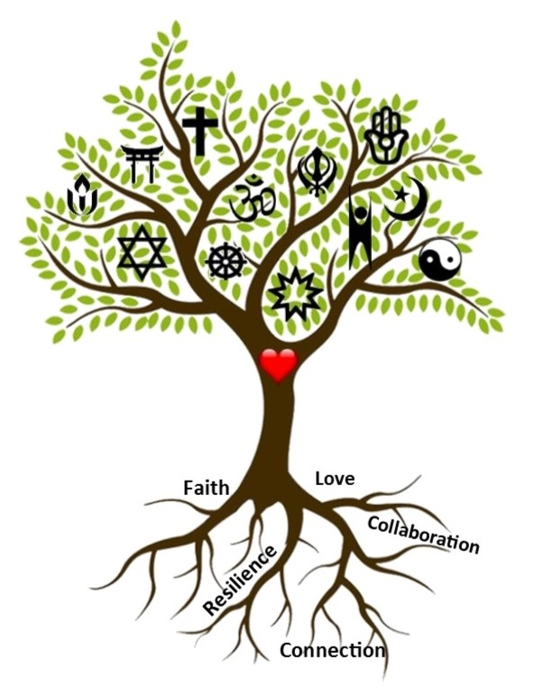
Convening at the Intersection of Trauma, Faith & Resilience to Connect, Learn, Heal & Serve January 30, 2020

Slide 2
Connecting to Others: Faith-Rootedness, Trauma & Resilience
Rev. Dr. Barbara Wilson, D. Min., Facilitator
bwilson@chipres.org
This session will define and explore the faith-rooted approach to relationship and community building, and offer a framework with practical tools for mitigating trauma, promoting healing and resilience within our communities.

Slide 3
OUTCOMES
Increased understanding of faith-rootedness in order to more fully connecting “being” and “doing” with corresponding impact (not intention).
Identify frameworks and practical tools through the lens of faith to become a trauma-conscious and healing–engaged faith community.
Develop a plan and commitment to engaging at least 1 of the frameworks.

Slide 4
RULES OF ENGAGEMENT
Eric Law’s “Respectful Communication Guidelines”
R – take Responsibility for what you say and feel without blaming others
E – use Empathetic listening
S – be Sensitive to differences in communication/cultural styles
P – Ponder what you hear and feel before you speak
E – Examine your own assumptions and perceptions
C – keep Confidentiality
T – Tolerate ambiguity because we are not here to debate. There are no “winners” or “losers.”
adapted from the Kaleidescope Institute

Slide 5
INTERFAITH PERSPECTIVES
Who’s In the Room?
*Baha’i Faith *Protestant Christianity *Islam
*American Indian *Jainism *Taoism *Sikhism
*Buddhism *Catholic Christianity *Judaism
*Church of Jesus Christ of Latter-Day Saints
*Orthodox Christianity *Confucianism *Shinto
*Zoroastrianism *Anglican Christianity *Hinduism

Slide 6
FAITH-ROOTEDNESS
Alexia Salvatierra
Faith-Rooted Approach/Organizing is Living, Serving, Leading, Building Relationships, Organizing as if God is REAL

Slide 7
FAITH-ROOTEDNESS
WHY?
The belief is that many aspects of spirituality, faith traditions, faith practices and faith communities can contribute in unique and powerful ways to the creation of just communities and societies.

Slide 8
FAITH-ROOTEDNESS
FRO is Defined & Differentiated by faithfully pursuing through your faith tradition two questions:
How can we insure that our collective work is shaped and guided in all ways by our faith?
Focus: Motivation/Rationale – the WHY (being)
How can we organize people of faith to enable them to contribute all of their unique gifts and resources to the broader movement for justice?
Focus: Methodology/Practices – the WHAT/HOW
(doing)

Slide 9
TABLE TALK ( 5 minutes)
BASED ON YOUR FAITH TRADITION:
Write on a postcard 1-3 of YOUR Existential Commitments or Principles, Beliefs, Core Values
Share with those at your table
THIS IS YOUR WHY!

Slide 10
FRAMEWORKS & PRACTICAL TOOLS
RISKING CONNECTION®:
Trauma-Informed for Faith Communities
Teaches a Relational Framework and skills that focuses on relationship as healing.
RICH Relationships are hallmarked by:
Respect Information Sharing
Connection Hope
Notes:
TO DO:

Slide 15
Notes:
TO DO: NAME 1-2 FACTORS THAT MAKE RELATIONSHIP BUILDING CHALLENGING FOR YOU? POPCORN STYLE

Slide 16
PRACTICAL TOOL: Faith-Rooted RELATIONAL MEETINGS
WHAT: Deliberate, intentional conversation to build and/or deepen a relationship.
Requires thoughtful, prayerful preparation
Person more important than self-interests
Mutuality and accountability
Sharing of stories and self-interests
Learn/share what’s important/values
Face to Face; deep listening
30-45 minutes (no more than 1 hour)
Notes:
NOTE THE DIFFERENCE IN THE FAITH ROOTED APPROACH TO ONE-ON-ONES

Slide 17
PRACTICAL Relational FRAMEWORK: Dignity Model Donna Hicks
Acceptance of Identity: Approach people as being neither inferior nor superior to you. Give others the freedom to express their authentic selves without fear of being negatively judged. Interact without prejudice or bias, accepting the ways in which race, religion, ethnicity, gender, class, sexual orientation, age, and disability may be at the core of other people’s identities. Assume that others have integrity.

Slide 18
Dignity Model – Donna Hicks
Inclusion: Make others feel that they belong, whatever the relationship—whether they are in your family, community, organization or nation.
Safety: Put people at ease at two levels: physically, so they feel safe from bodily harm, and psychologically, so they feel safe from being humiliated. Help them to feel free to speak without fear of retribution. Acknowledgement: Give people your full attention by listening, hearing, validating, and responding to their concerns, feelings and experiences.

Slide 19
Dignity Model – Donna Hicks
Recognition: Validate others for their talents, hard work, thoughtfulness, and help. Be generous with praise, and show appreciation and gratitude to others for their contribution and ideas.
Fairness: Treat people justly, with equality, and in an even-handed way according to agreed-on laws and rules. People feel you have honored their dignity when you treat them without discrimination or injustice.
Benefit of the Doubt: Treat people as trustworthy. Start with the premise that others have good motives and are acting with integrity.

Slide 20
Dignity Model – Donna Hicks
Understanding: Believe that what others think matters. Give them the chance to explain and express their points of view. Actively listen in order to understand them.
Independence: Encourage people to act on their own behalf so that they feel in control of their lives and experience a sense of hope and possibility. Accountability: Take responsibility for your actions. If you have violated the dignity of another person, apologize. Make a commitment to change hurtful behaviors.

Slide 21
FAITH-ROOTEDNESS IS CONNECTING BEING WITH DOING
Fr. Richard Rohr, Founder, Center for Action & Contemplation – 2 of 8 core principles
We need a contemplative mind in order to do compassionate action. (process)
We do not think ourselves into a new way of living, but we live ourselves into a new way of thinking. (praxis/practice over theory)

Slide 22
FAITH-ROOTEDNESS, HEALING TRAUMA, BUILDING RESILIENCE
Faith-Rootedness – Defined
Frameworks Explored for Healing Relationships: RICH Relationships & Dignity Model
Practical Relational Tool: Relational Meetings or One-on-Ones

Slide 23
Connecting to Others: Faith-Rootedness, Trauma & Resilience
THE CHALLENGE:
Through the lens of our FAITH, build and deepen HEALING RELATIONSHIPS that:
Create intentional space for authenticity that helps to mitigate the effects and impact of trauma
Build resilience as we practice our faith with concrete action over time.

Slide 24
Connecting to Others: Faith-Rootedness, Trauma & Resilience
Commitment:
Choose today to utilize the RICH Relationship Framework, or Relational Meetings Tool, or the Dignity Model to build and deepen YOUR relationships to heal trauma and build resilience.
THANK YOU!

